Slide 1
ATP Genrator

Slide 2
Outline
1.Installation
Anaconda 3.7+
2.Introduction for the Script
2-1. Arguments
2-2. Input Excel File

Slide 3
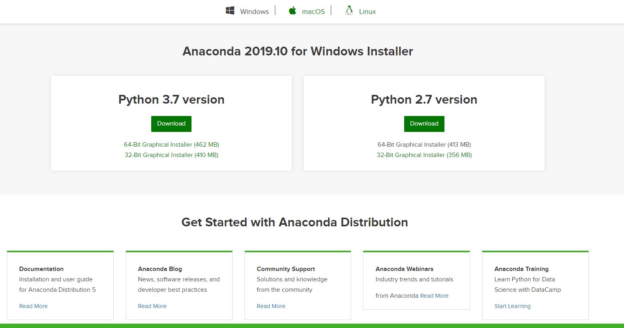
Anaconda 3.7+
Please install Anaconda 3.7+

Slide 4
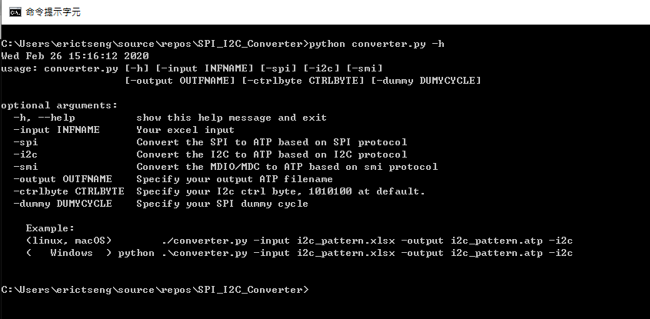
Arguments
Launch your Windows terminal, and enter the folder where the script is located.
All the arguments can be shown in the “help”

Slide 5
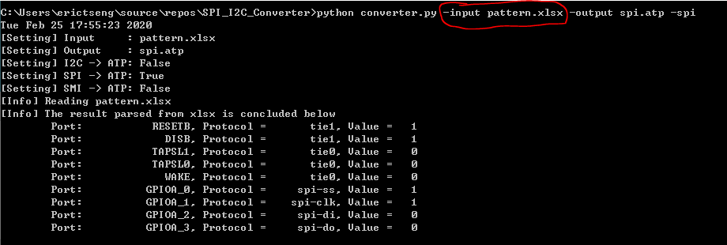
Arguments “-input Pattern.xlsx”
Argument “-input” is used to specify your input Excel file, which must be xlsx format. (csv is not allowed)

Slide 6
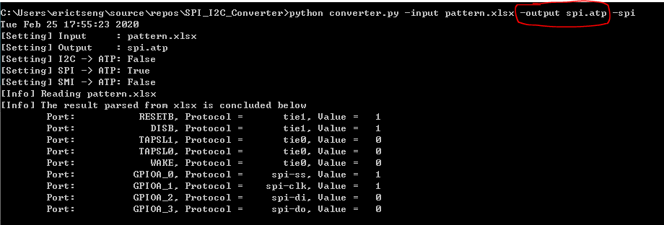
Arguments “-output output.atp”
Argument “-output” is used to specify your output ATP file. It’s optional.

Slide 7
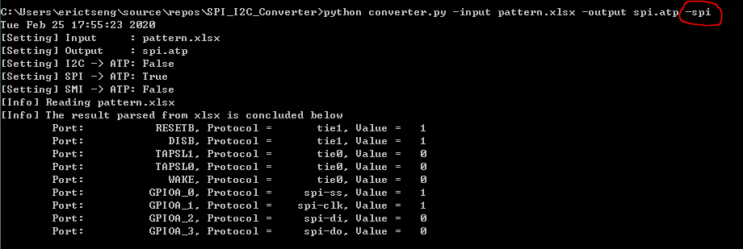
Arguments “-i2c”, “-spi” or “-smi”
Argument “-i2c”, “-spi” or “-smi” is used to specify which protocol you will apply.

Slide 8
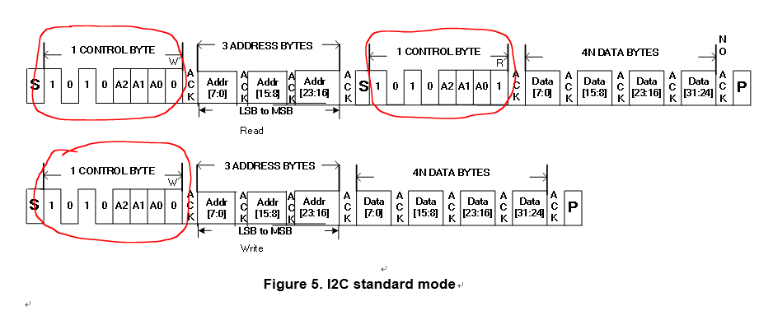
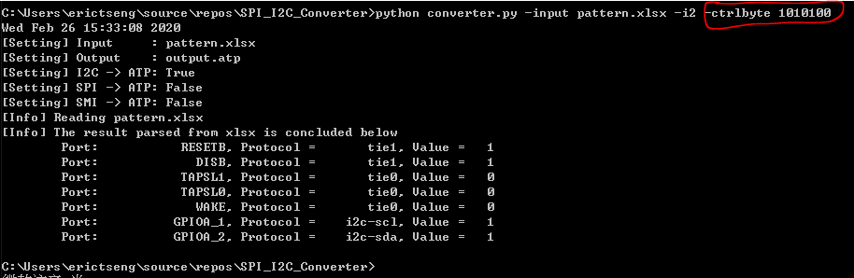
Arguments “-ctrlbyte” for I2C

Slide 9
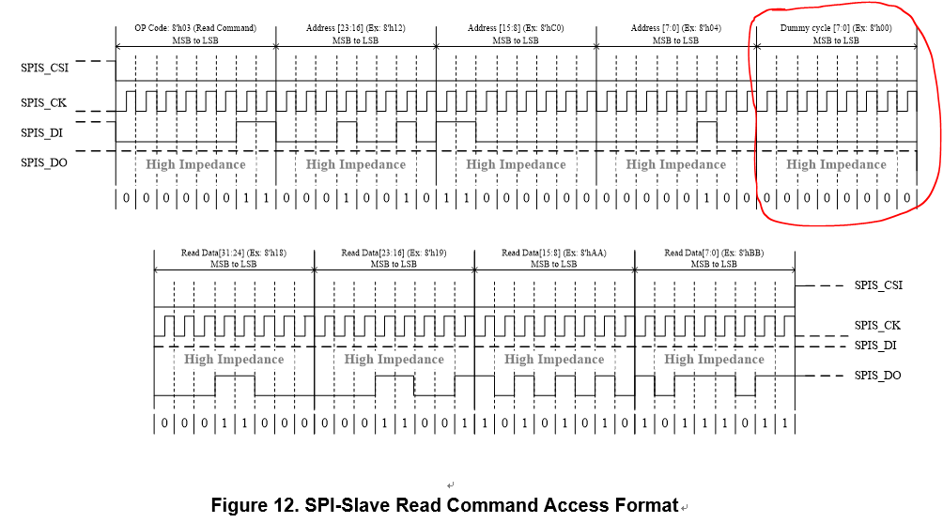
Arguments “-dummy” for SPI

Slide 10
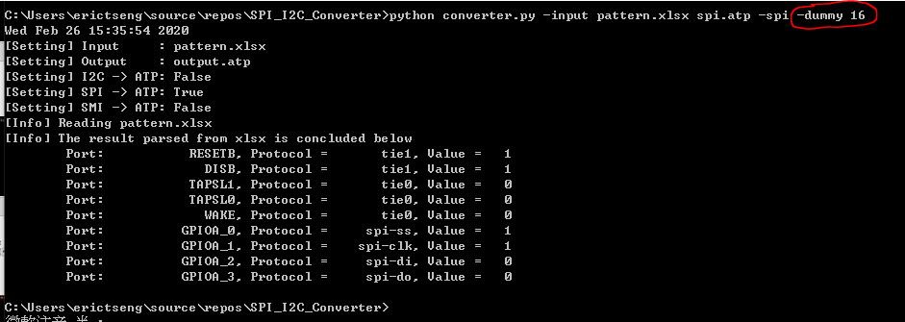
Arguments “-dummy” for SPI

Slide 11
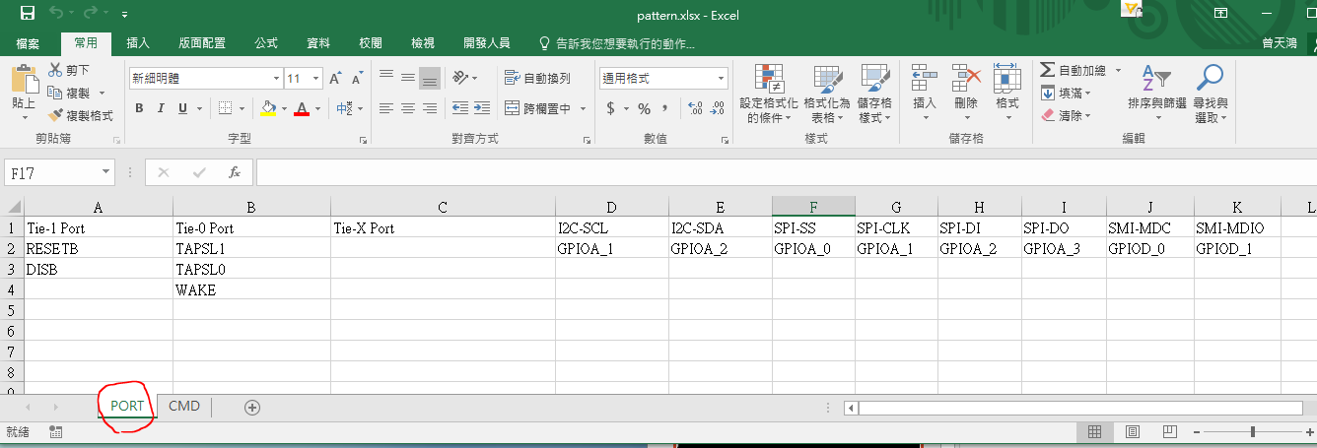
Input Excel File
Declare your ports for bonding options or other protocols, in the worksheet “PORT”

Slide 12
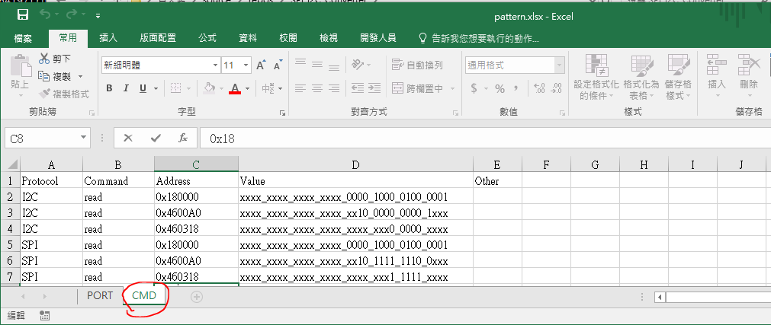
Input Excel File
Write your commands in the worksheet “CMD”

